Slide 1
COVID-19 VACCINE ANALYSIS
Data is collected daily from Our World in Data GitHub repository for covid-19, merged and uploaded. Country level vaccination data is gathered and assembled in one single file. Then, this data file is merged with locations data file to include vaccination sources information. A second file, with manufacturers information, is included.

Slide 2
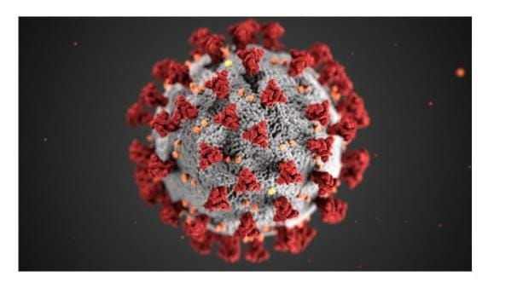

Slide 3
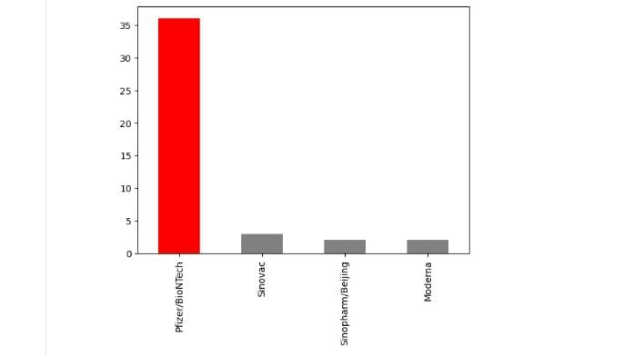
https://www.kaggle.com/datasets/gpreda/covid-world-vaccination-progress
Items in the dataset:
Countries
Dates
Vaccines
Total vaccinations
Desired data to find:
Most commonly used vaccines in countriesAverage daily vaccination count in countries -Number of countries where vaccines are usedChoropleth map of the most used vaccine

Slide 4
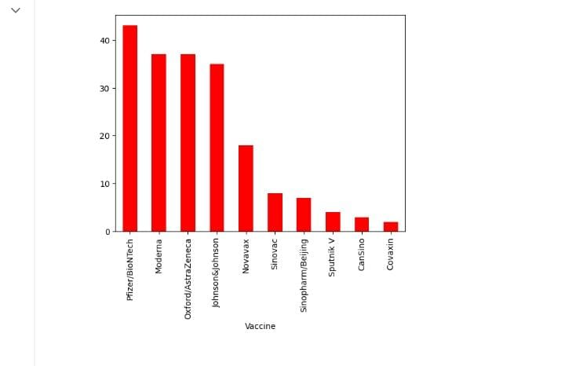
Number of countries where vaccines are used

Slide 5
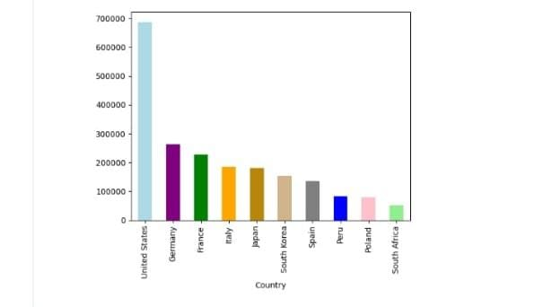
Average daily vaccination count in countries

Slide 6
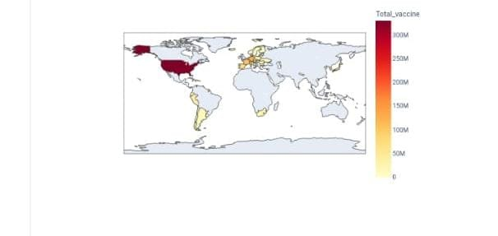
choropleth map of the most used vaccine

Slide 7
Content: The data (country vaccinations) contains the following information: Country- this is the country for which the vaccination information is provided; Country ISO Code - ISO code for the country;Date - date for the data entry; for some of the dates we have only the daily vaccinations, for others, only the (cumulative) total;Total number of vaccinations - this is the absolute number of total immunizations in the country;Total number of people vaccinated - a person, depending on the immunization scheme, will receive one or more (typically 2) vaccines; at a certain moment, the number of vaccination might be larger than the number of people;Total number of people fully vaccinated - this is the number of people that received the entire set of immunization according to the immunization scheme (typically 2); at a certain moment in time, there might be a certain number of people that received one vaccine and another number (smaller) of people that received all vaccines in the scheme;

Slide 8
Daily vaccinations (raw) - for a certain data entry, the number of vaccination for that date/country;Daily vaccinations - for a certain data entry, the number of vaccination for that date/country;Total vaccinations per hundred - ratio (in percent) between vaccination number and total population up to the date in the country;Total number of people vaccinated per hundred - ratio (in percent) between population immunized and total population up to the date in the country;Total number of people fully vaccinated per hundred - ratio (in percent) between population fully immunized and total population up to the date in the country;Number of vaccinations per day - number of daily vaccination for that day and country;Daily vaccinations per million - ratio (in ppm) between vaccination number and total population for the current date in the country;Vaccines used in the country - total number of vaccines used in the country (up to date);Source name - source of the information (national authority, international organization, local organization etc.);Source website - website of the source of information;There is a second file added recently (country.

Slide 9
Location - country;Date - date;Vaccine - vaccine type;Total number of vaccinations - total number of vaccinations / current time and vaccine type.Acknowledgements:I would like to specify that I am only making available Our World in Data collected data about vaccinations to Kagglers. My contribution is very small, just daily collection, merge and upload of the updated version, as maintained by Our World in Data in their GitHub repository

